Slide 1



Voice Enhancement with Deepfake voice

Slide 2
Team Members and Project Adisor
Project Advisor : Dr.Enshirah Ibrahim Abdel H. Altarawneh
Noorelddin Abedwlhamid Housni Shamroukh
OSAMAH MUNEER RADWAN RADWAN
ABDEL RAHMAN ZAID KHAMEES ELTAH
TOLEEN OSAMA SALEH ABU ALI

Slide 3
TABLE OF CONTENTS
01
06
03
04
05
ABOUT THE PROJECT
Problem We counter
02
Noise Cancellation
07
Conclusion
Preparation for training & resources gathering
08
Testing
Voice Converter
Ai Voice Detection

Slide 4


01
ABOUT THE PROJECT

Slide 5

Introduction
In voice communication today, several problems affect how we hear, speak, and trust what we hear.
Many people struggle with background noise that makes voices unclear in calls or recordings.
Others want to change how their voice sounds for privacy, accessibility, or creative reasons but don’t have the tools to do so.
And with the rise of AI, it’s becoming harder to tell if a voice is real or fake, which creates serious concerns around trust and security.

Slide 6
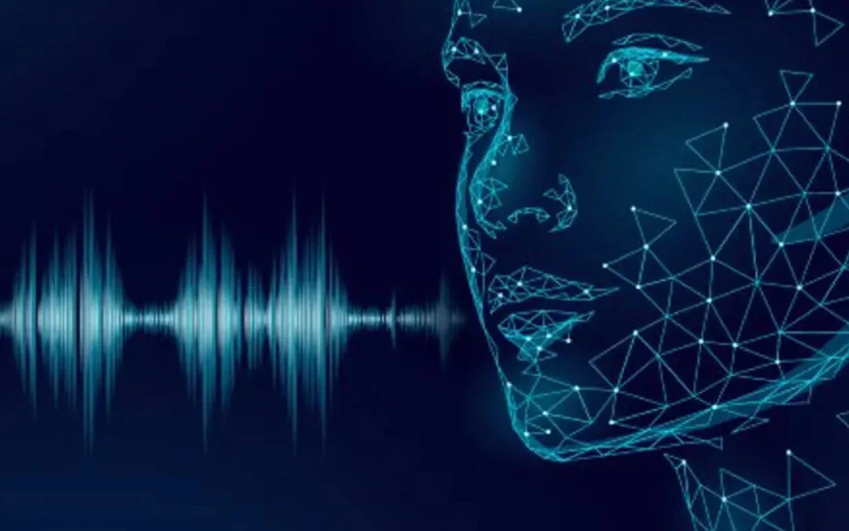
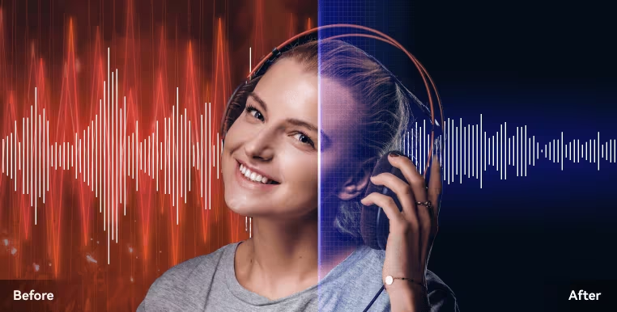
OUR VISION
Our project explores three vital tools in response to these problems :
A Noise Cancellation Tool to enhance voice quality by removing unwanted background sounds.
A Voice Changing System that transforms a speaker's voice into another, based on trained voice models.
An AI Voice Detection Tool capable of identifying whether a voice is real (human) or synthetically generated (AI deepfake).

Slide 7
02
Noise Cancellation

Slide 8
Colab Setup – Why It Matters
The Purpose of the Colab NotebookThe Colab notebook :
serves as the execution environment for our noise cancellation tool.It prepares everything we need before running the core logic in do_it.py.
Why We Use It ?
✅ Runs in the cloud No need for powerful local hardware — we can run heavy AI models like Demucs and Whisper using Google’s free GPUs.
✅ Ensures Python 3.10 compatibility All libraries used in our tool (Demucs, Whisper, Noisereduce, etc.) are stable with Python 3.10, so we install and use this version to avoid errors.
✅ Handles dependencies and file uploads The notebook installs all required packages and lets us upload audio files and run the script directly.

Slide 9
Noise Cancellation Model (Colab-Based)-Structure
Cell .No | Description
Cell 1 | Sets up the environment by installing Python 3.10 and pip — needed because Colab defaults to older versions not fully compatible with our libraries.
Cell 2 | Installs all required packages for audio processing and noise reduction, including: torch, demucs, noisereduce, librosa, and ffmpeg.
Cell 3 | Uses files.upload() to allow users to upload their audio files (e.g., a noisy .mp3).
Cell 4 | Runs the main script do_it.py , which applies the noise cancellation model to the input audio and produces a cleaned .wav file.
We will show How these Cells Worked together with more explaining at the End on Testing….

Slide 10
How the Main Code works?
Tools & Libraries
What Does the Script Do?
Takes a noisy audio file.
Removes background sounds.
Keeps and enhances only clean human speech.
Outputs a clear, filtered audio file.
Library | Purpose
Demucs | Vocal/music separation
Whisper | Speech recognition
librosa, numpy | Filtering audio
pydub | Audio volume, silence
torchaudio | Load/save .wav files
ffmpeg | Combine audio files

Slide 11
How the Main Code Works ?
Step 2 – Speech Detection
Step 1 – Vocal Separation
ISolating Speech Using Demucs:
input.mp3 → [Demucs] → vocals.wav, drums.wav, bass.wav...
Key Function: separate_with_demucs()Highlights:
Converts mono → stereo (if needed).
Extracts vocals for further processing.
Using Whisper to Detect Human SpeechKey Function:
detect_and_keep_speech()Bullet Points:
Whisper copy the audio.
If real speech is detected:
Audio is kept.
Otherwise:
It’s ignored or replaced with silence.

Slide 12
How the Main Code Works ?
Step 3 – Noise Filtering
Step 4 – Silence Detection
Bandpass Filter to Clean FrequenciesFunction: bandpass_filter() Bullet Points:
Keeps frequencies between 100Hz and 8000Hz (speech).
Removes low rumble and high hiss.
Uses FFT to apply filtering.
Replacing Silence or Low VolumeBullet Points:
If speech is too quiet (below -35 dB):
Replaces it with silence.
If no speech detected at all:
Whole section becomes silent.
Function Used: AudioSegment.silent()

Slide 13
How the Main Code Works ?
Key Challenges & Learnings
Step 5 – Merging Audio (Optional )
Compatibility management with Python versions.
Handling edge cases (silence, mono audio).
Optimizing performance using GPU (CUDA).
Combining deep learning with traditional DSP.
Merging Chunks into Final Output
Function: combine_chunks()
Bullet Points:
Uses FFmpeg to merge audio files.
Produces one final output .wav

Slide 14
Summary of the Main code structure
Component | Description
setup_directories() | Creates fresh output folders: one for cleaned speech, one for final enhanced output.
separate_with_demucs() | Uses the Demucs AI model to isolate vocals from background noise/music. Saves separated tracks, especially vocals.wav.
detect_and_keep_speech() | Uses OpenAI's Whisper model to detect if the audio contains actual speech. Prevents saving non-speech noise.
bandpass_filter() | Applies a frequency filter (100Hz–8000Hz) to remove unwanted low/high frequencies while preserving voice range.
process_full_audio() | Main function to: 1) isolate vocals, 2) detect speech, 3) apply filtering or silence audio if needed.
combine_chunks() | Merges processed audio chunks (if more than one) into a single output using FFmpeg.
main() | Executes all steps above in the correct order based on command-line inputs (input file, output file).

Slide 15
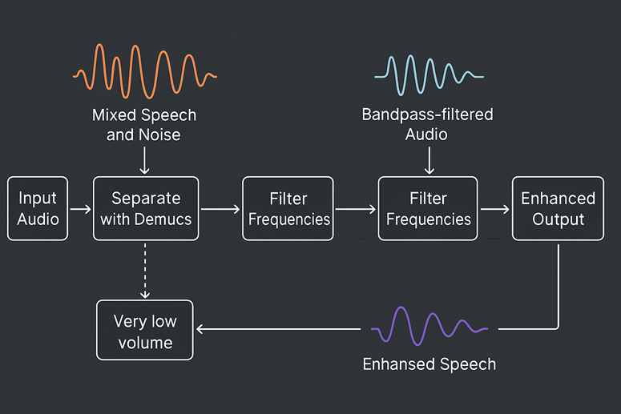
Model Pipeline Summary ( do_it .py )

Slide 16
03
Preparation for training & resources gathering

Slide 17
Preparing Audio Data for Voice Conversion and detection Models
- Objective: Build an integrated system to prepare audio files for training a voice conversion model.
- Composed of three connected stages:
1. Audio preprocessing (silence removal, segmentation).
2. Feature and F0 extraction from the processed clips.
3. Creating datasets for classification (real vs fake voice)

Slide 18
Preparing Audio Data for Voice Conversion and detection Models
conversion
conversion
detection
remove silence /segment
preparing the fectures
fake/real

Slide 19
Stage 1 - Audio Preprocessing
This code is designed to process a .wav audio file that has been uploaded, with the following steps:
An audio file (containing one or more voices) is uploaded to the working environment (in this case, Google Colab).
Silent parts of the audio file are removed, leaving only the segments that contain actual voice.
These voice segments are then divided into smaller clips, each approximately 6 seconds long.
The resulting clips are compressed into a ZIP file for easy download.

Slide 20
Installing Two Essential Libraries:
librosa: A library for analyzing and processing audio data.
soundfile: A library used for reading and writing audio files.
This class is responsible for:
Analyzing the audio file.
Detecting silent sections based on sound level (RMS energy).
Splitting the audio into non-silent segments.

Slide 21
CONTENTS OF THE KEY PARAMETER
Variable | Meaning
threshold | Threshold to determine when a segment is considered "silent"
min_length | Minimum duration of audio required to consider it a valid clip
min_interval | Minimum silence duration needed to split between audio segments
hop_size | Time interval between each energy (RMS) measurement
max_sil_kept | Maximum silence allowed to keep before/after a segment

Slide 22
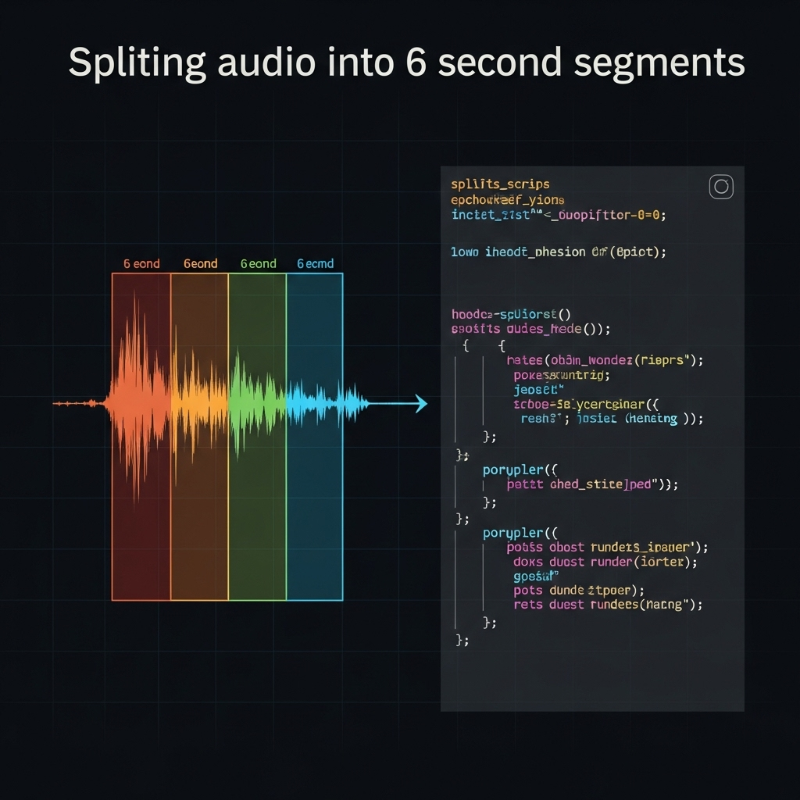
Why exactly 6 seconds?
1. Balance between length and clarity
Very short clips (e.g., less than 1–2 seconds) may not contain enough information to capture meaningful voice patterns.
Very long clips (e.g., more than 10–15 seconds) are harder to process, require more memory, and make it difficult to model fine-grained variations within the audio.
2. Suitable for many types of applications
3. Memory and performance constraints in training
4. Data consistency for training

Slide 23
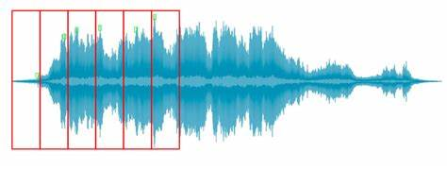
Why Do We Remove Silent Parts from an Audio File? What's the Purpose of This Step?
1. Improve Data Quality for Training
2. Reduce Data Size and Speed Up Training
In tasks like voice conversion, speech recognition, or audio generation:
Excessive silence can lead to poor results, such as:
Long unnatural pauses,
Lack of smoothness in output, Misalignment in synthesized or processed audio.
3. Improve Model Efficiency
4. Facilitate Audio Segmentation
5. Enhance Post-Processing Tasks

Slide 24
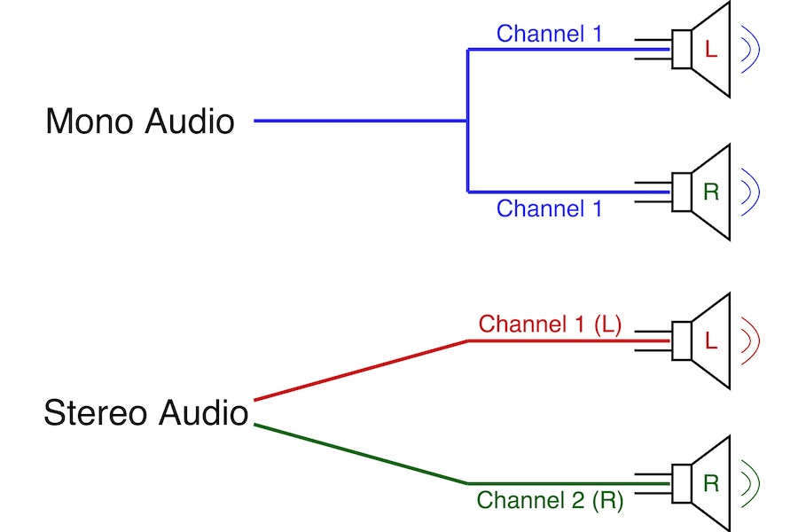
What Does "Mono" Mean?
A mono audio file means it contains only one audio channel (Channel = 1).
A stereo audio file contains two channels, usually:
One for the left ear (Left Channel)
One for the right ear (Right Channel)

Slide 25
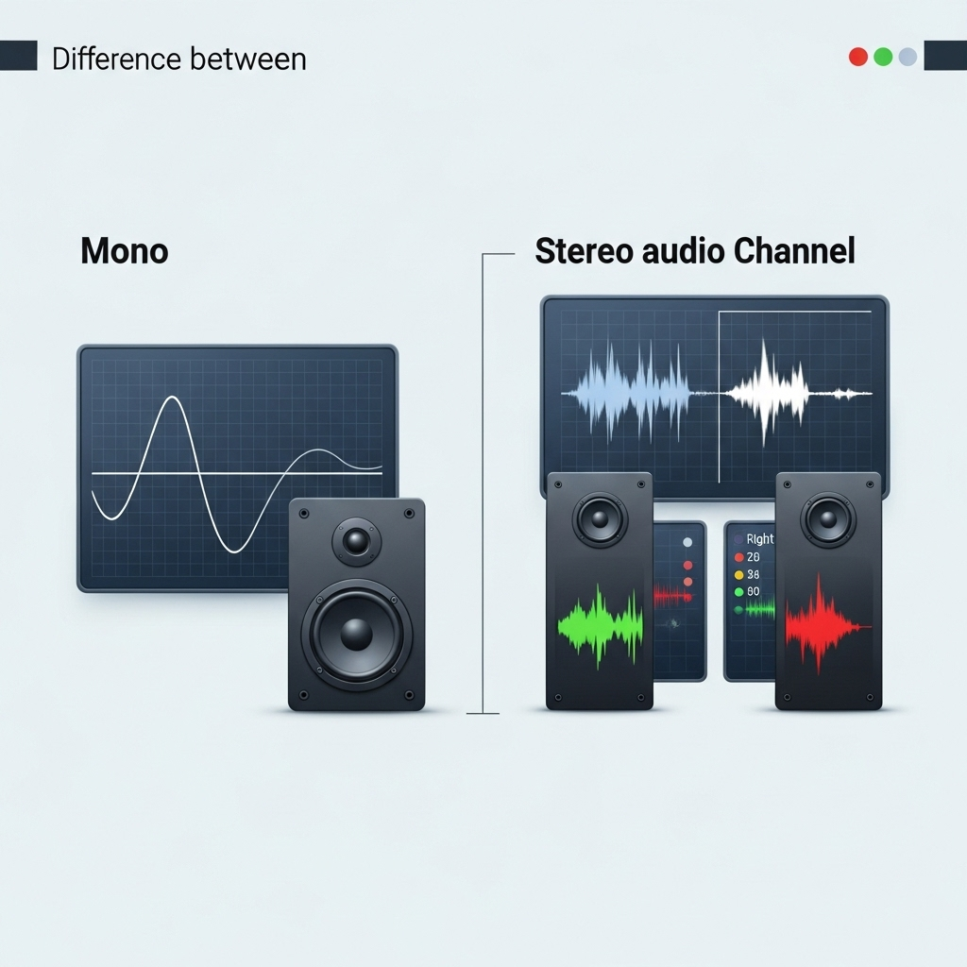
Why Should the Audio Be Mono?
The function librosa.feature.rms() calculates the Root Mean Square (RMS) energy of each audio frame.
This function expects 1D audio data (single channel).
If you pass a 2D array (stereo audio), it will either:
Throw an error,
Or return incorrect or misleading results (like computing RMS separately for each channel).

Slide 26
What Happens If You Don’t Convert to Mono?
Or, the RMS calculation will be done separately for each channel, leading to:
Confusing silence detection,
Unreliable segmentation.
Always convert audio to mono before using functions like librosa.feature.rms() to ensure correct and stable behavior.

Slide 27
🔍 If waveform.ndim == 1:
The audio file is already mono (single channel)
→ Use it as is.
🔍 If waveform.ndim == 2:
The audio file is stereo (two channels)
→ Apply mean(axis=0) to merge the two channels into one by averaging them.
This is a common and acceptable technique in many audio processing applications.

Slide 28
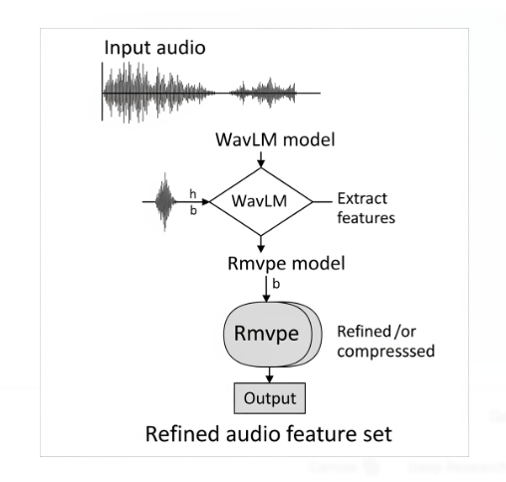
Stage 2 - Feature Extraction
- Convert audio to mono.
- Extract features using WavLM.
- Extract F0 using RMVPE model.
- Save data to: feature_path and f0_path.

Slide 29
prepare audio data (WAV files) for voice processing tasks.
The main steps are:
1. 🧹 Clean up folders
2. 🎧 Load and process the audio
3. 🧠 Extract acoustic features using WavLM
4. 🎵 Extract fundamental frequency (F0) using RMVPE
5. ✅ Logs progress

Slide 30
Tool Setup:
We use two models:
🔹 WavLM → to extract smart information (features) from audio.
🔹 RMVPE → to estimate the pitch (F0) of the voice.
We also load settings like sample rate and folder paths from the config file.

Slide 31
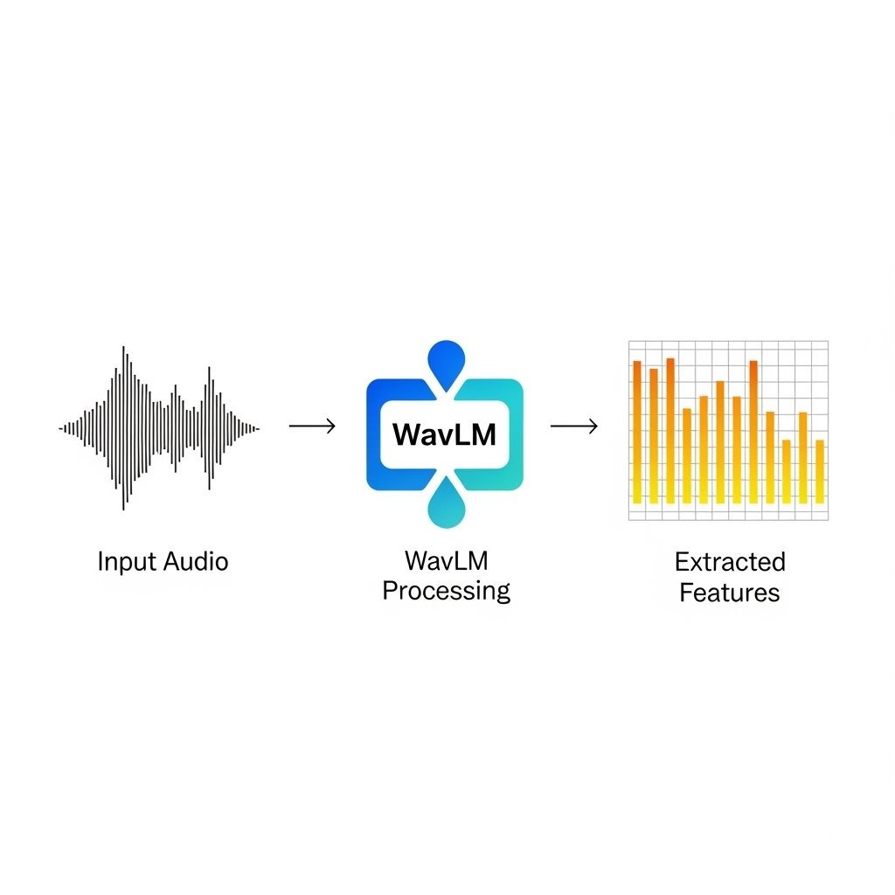
WavLM
WavLM is an AI model developed by Microsoft.
🔊 What does it do?
It takes your voice (like a WAV file) and understands what's inside.
It converts the audio into smart numeric features — numbers that represent things like pitch, speed, emotion, and background noise.
🎯 Why is it important?
Because it helps other models understand audio more easily.
It’s useful for tasks like:
Speaker identification
Audio enhancement
Voice conversion

Slide 32
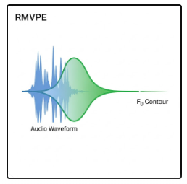
RMVPE
🔹 RMVPE is an AI model specialized in audio.
🎯 What does it do?
It analyzes audio and calculates the fundamental frequency (F0) —
This tells us how high or low the pitch is at every moment.
📊 Why is it important?
Because it helps other models understand audio more easily.
It’s useful for tasks like:
Speaker identification
Audio enhancement

Slide 33
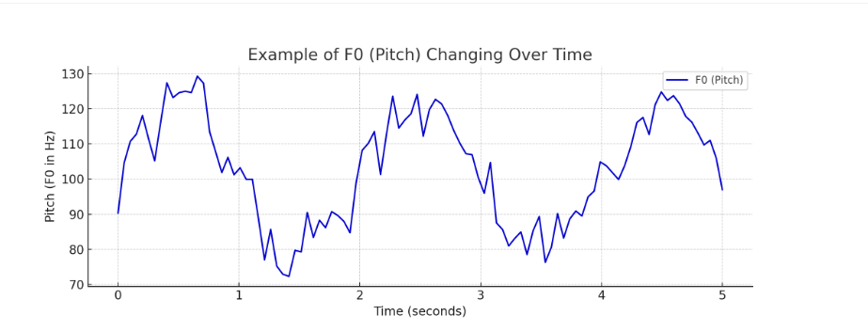

Slide 34
What happens during execution?
Folder | When is it used? | What happens in it?
RAW_DIR | At the beginning | Loads original .wav files from here
PROC_DIR | After audio processing | Stores the cleaned and resampled version of each audio file
FEAT_DIR | After WavLM feature extraction | Saves .pt files containing extracted features for each audio file
F0_DIR | After F0 extraction using RMVPE | Saves .pt files containing the F0 (pitch) values for each audio file

Slide 35
Processing Each Audio File:
Feature Extraction:
Pitch Extraction:
Convert the audio to mono (single channel).
Resample it to the target sample rate.
Normalize the volume to make it clean and consistent.
Save the processed audio to a specific folder.
Use WavLM to analyze the audio and convert it into smart features (a numeric representation of the voice).
Use RMVPE to calculate the fundamental frequency (F0) — basically, how high or low the voice is at each moment.

Slide 36
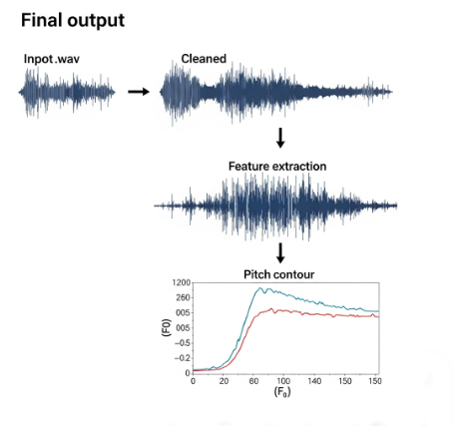
Final Output:
For each input .wav file, you get:
A cleaned audio file
A feature representation of the voice
The pitch (F0)
All ready for voice-related projects like training models, voice conversion, or enhancement.

Slide 37
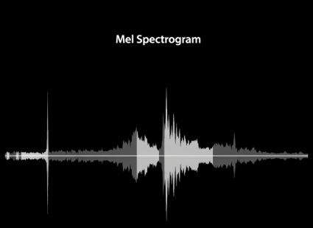
Stage -3detection
The code prepares audio data (real or fake) in a way that helps the model learn to distinguish between them using Mel Spectrogram representations, with the possibility of improving the model through some random audio augmentations during loading.

Slide 38
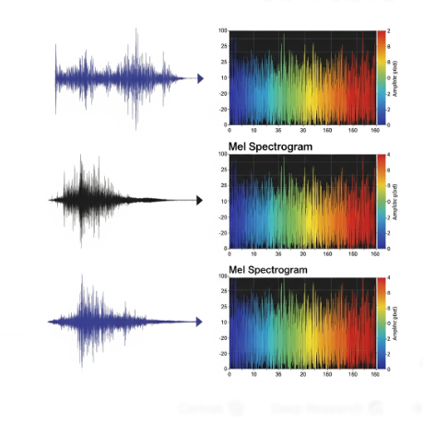
Mel Spectrogram works as follows:
1-Split the audio into small time frames (e.g., every 25 milliseconds).
2-Transform each frame into frequency components using the Fourier Transform (FFT).
3-Map the frequencies onto the Mel scale, which mimics human hearing by focusing more on lower frequencies.
4-Calculate the energy (intensity) of each frequency band and convert it into a logarithmic scale (decibels).

Slide 39
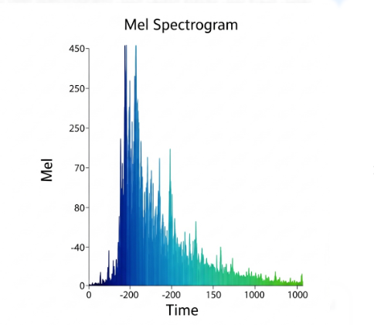
🔁 The result is a 2D matrix (like an image) that represents:
1-Horizontal axis: Time
2-Vertical axis: Mel frequencies
3-Values in the matrix: Intensity of the sound
**This representation acts as a "visual image of sound", allowing the model to learn meaningful patterns effectively.

Slide 40
We use the Mel Spectrogram because it's one of the most effective representations of audio for helping AI models understand and analyze sound. Here's why:
✅ 1. Mimics Human Hearing
The Mel scale focuses on frequencies that humans hear more clearly (especially in speech).
This helps the model "learn like a human" and identify meaningful differences.
✅ 2. Converts Audio into an Image
Modern models (like CNNs) are very good at processing images.
By turning sound into a visual representation (Mel Spectrogram), the model can recognize audio patterns such as:
Who is speaking?
Is the voice real or fake?
What word was spoken?

Slide 41
3. Shows Frequency Changes Over Time
The Mel Spectrogram displays how tones and frequencies evolve over time,
which is essential because sound is constantly changing, and the model needs to capture that dynamic behavior.
4. More Stable and Easier to Learn From
Compared to raw waveforms, spectrograms are more structured and easier for the model to learn useful features from.
***The Mel Spectrogram transforms sound into a smart visual format that highlights important information in a way similar to how humans perceive it. This helps models learn faster and more accurately.

Slide 42
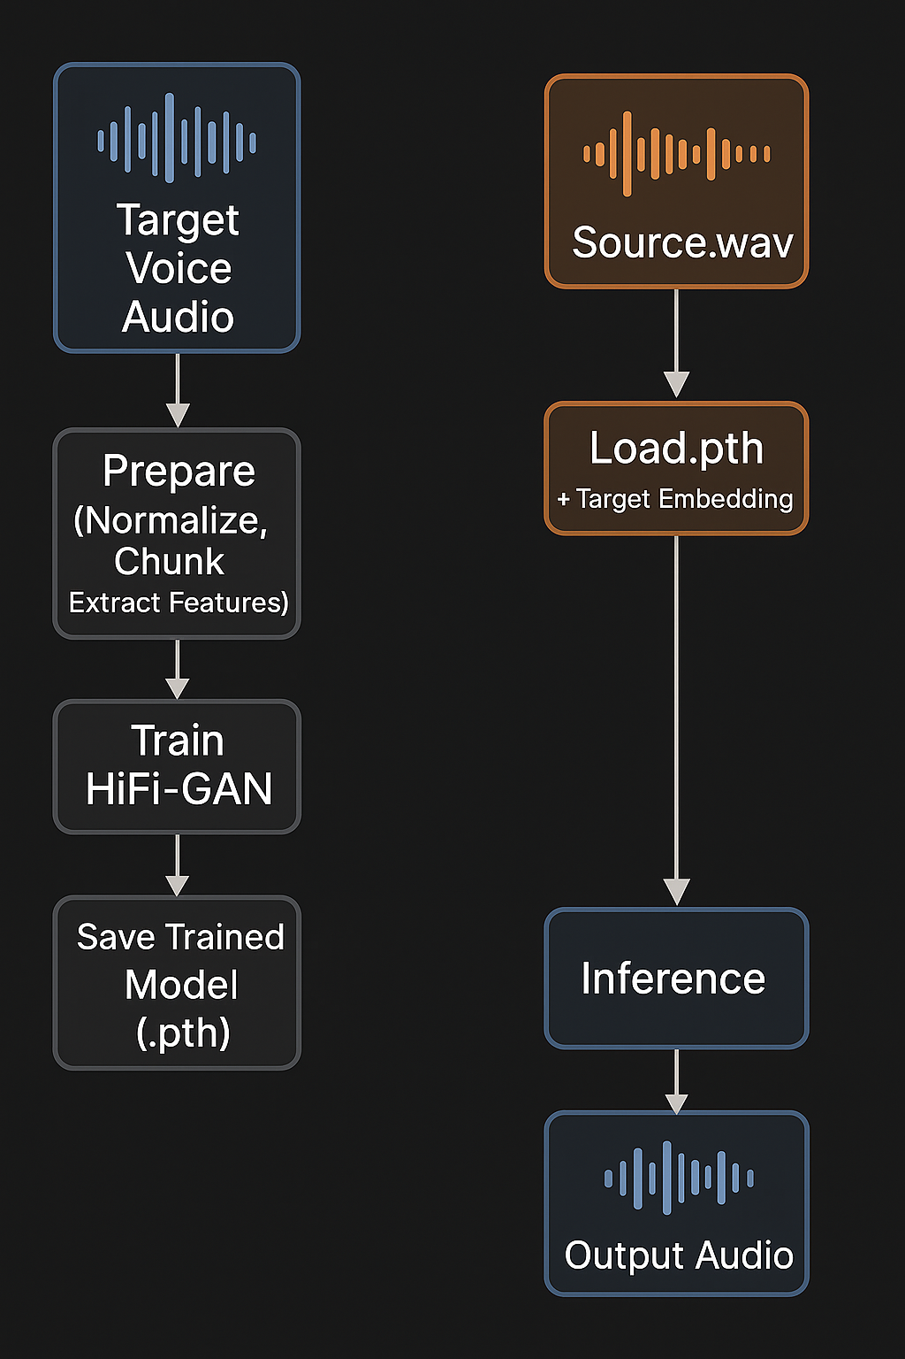
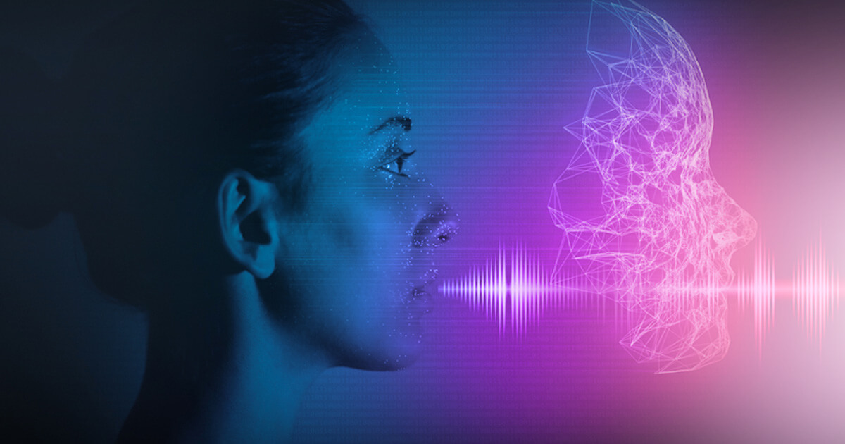
04
Voice Converter

Slide 43
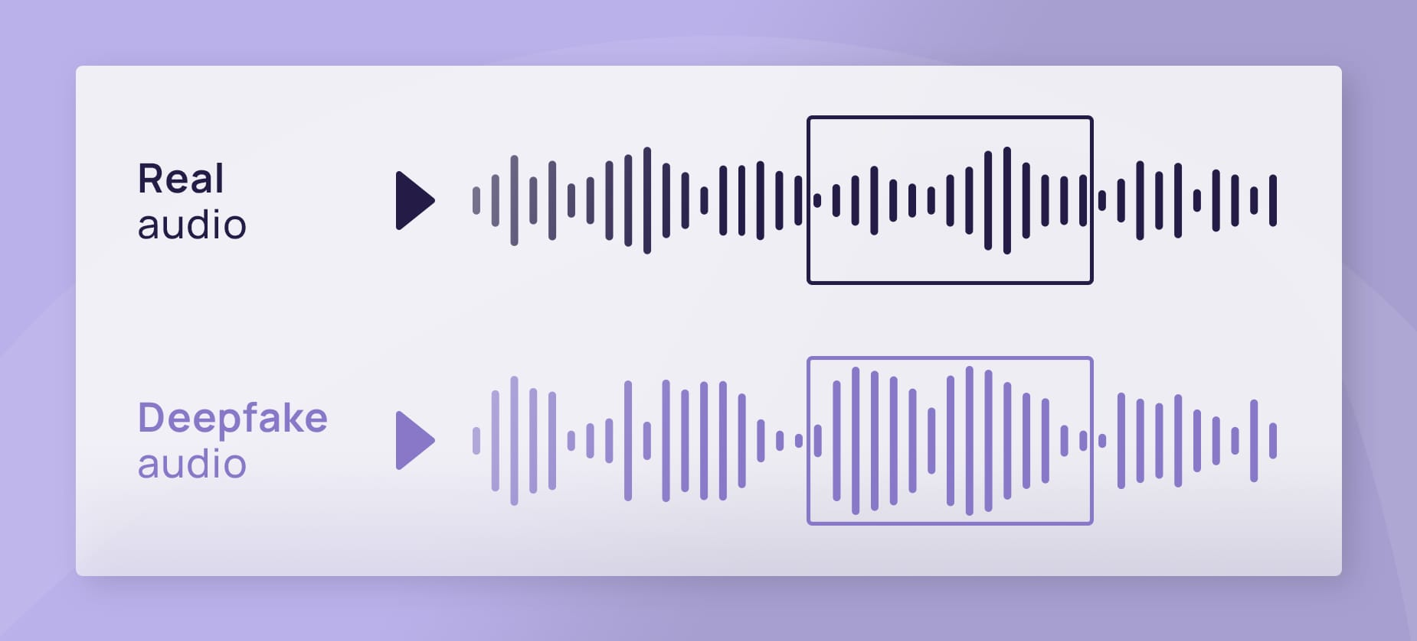
Our Solution: AI-Based Voice Conversion
Our system enables a speaker to transform their voice into another speaker’s voice by training on a target voice reference.
Stages:
Audio Preprocessing
Feature Extraction
3.HiFi-GAN Training
Voice Conversion (Inference)

Slide 44
stage1:Audio Preprocessing
Purpose:
Prepare raw audio for feature extraction and model input by cleaning, normalizing, and segmenting it.
Steps Involved
1.Mono Conversion 2.Volume Normalization 3.Silence Trimming 4.Resampling 5.Chunking into 6 Seconds
Why Chunking Matters ?
1.Ensures equal-sized model input.
2.Prevents GPU memory overload.

Slide 45
Stage2:Feature Extraction (WavLM + RMVPE)
Purpose:
Extract deep voice characteristics that describe what is said and how it’s said.
WavLM:
Captures semantic and acoustic features from speech.
Produces a 768-dimensional vector per frame.
Final Output:
Concatenated vector: 768 (WavLM) + 1 (F0) = 769 dimensions.
Saved as .pt tensor (PyTorch format) for both training and inference.
RMVPE:
Specialized model to extract pitch (F0).
Based on U-Net + BiGRU.
Returns a 1D curve representing intonation (how high or low voice goes).
Output is smoothed for better synthesis.

Slide 46
Stage3:HiFi-GAN Training
Purpose:
Train a neural vocoder that learns to generate natural-sounding speech from extracted features.
Model Components:
1.Generator:
transposed convolutions
dilated residual blocks
Tanh activation
2.Discriminators:
MPD – Multi-Period Discriminator
MSD – Multi-Scale Discriminator
3. Loss Functions
L1 Loss
STFT Loss
Feature Matching Loss
Adversarial Loss
Training OutputBest checkpoint saved as: hifigan_model_best.pth

Slide 47
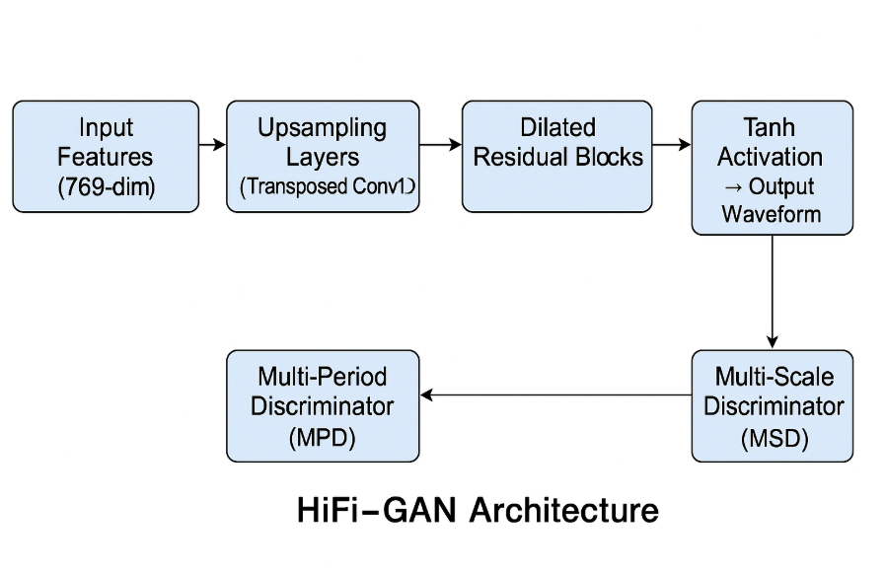
HiFi-GAN Training

Slide 48
Inference Pipeline (Voice Conversion)
Steps:
1. Audio Input
2. Feature Extraction(WavLM/RMVPE)
3. Speaker Embedding
4. HiFi-GAN Synthesis
5. Output

Slide 49
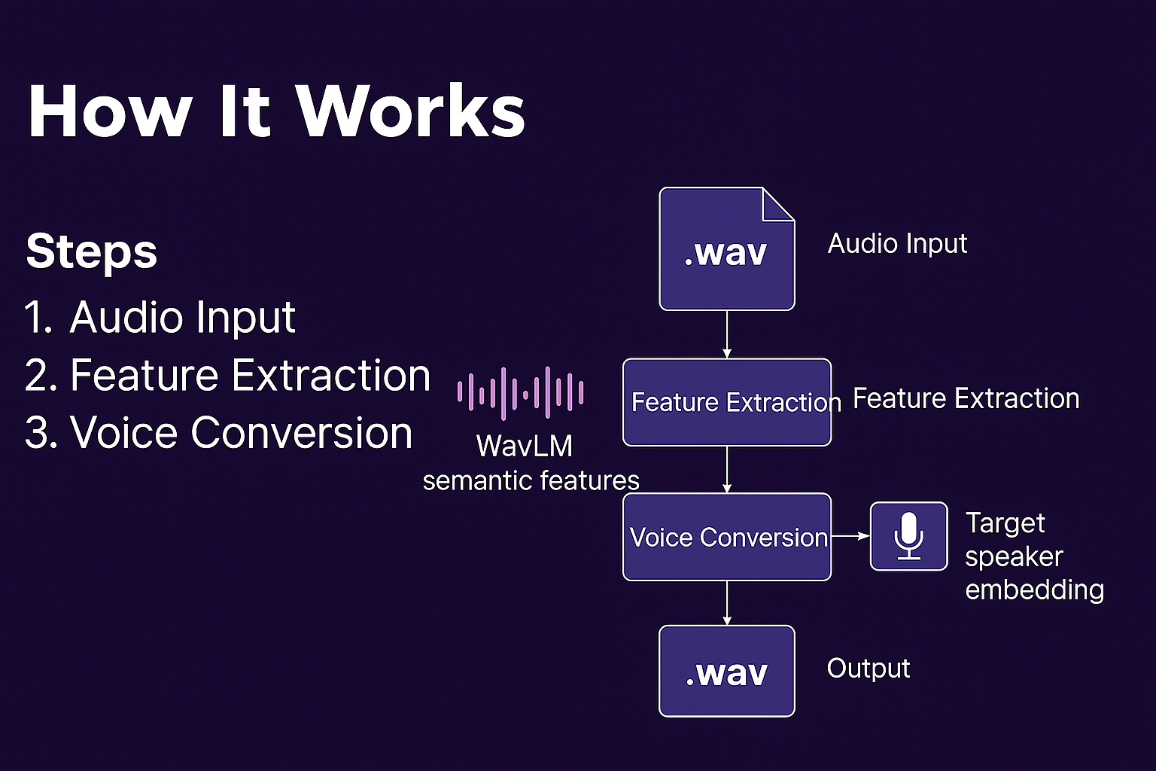

Slide 50
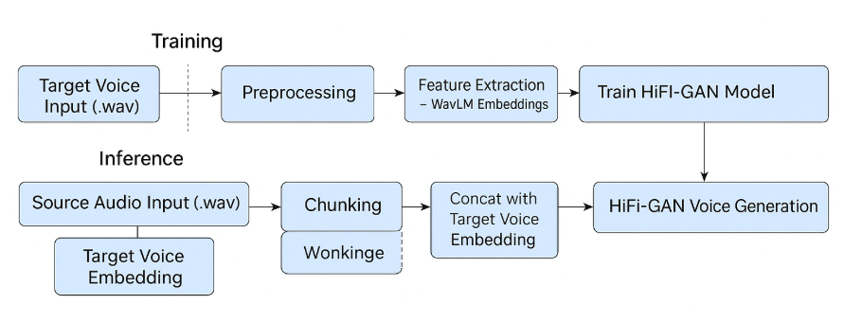
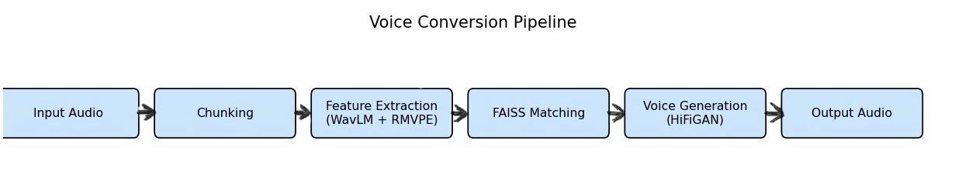
Voice Converter PIPLINE

Slide 51
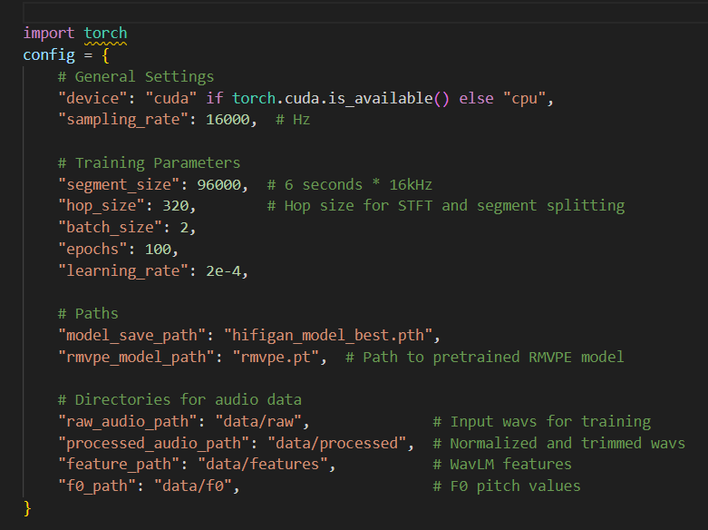
Centralized Configuration – The Control Center
Core Purpose:
The config_svc.py file centralizes all critical parameters that govern the entire voice conversion pipeline, ensuring consistency and flexibility across:
Preprocessing → (prepare_data_svc.py)
Training → (train_svc.py)
Inference → (inference_svc.py)

Slide 52
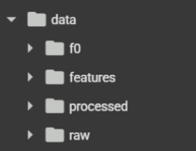
Critical Directory Paths
Path Key | Description
raw_audio_path | Directory for raw input audio files
processed_audio_path | Stores normalized audio
feature_path | Stores extracted WavLM features
f0_path | Stores computed pitch (F0) values

Slide 53
Voice Conversion Made Accessible
Google Colab Interface (voice_converter_svc_colab.ipynb)
Key Features
User-Friendly Demo
Designed for non-technical users
Just upload an audio file and run the cells
One-Click Setup
Automatically installs all dependencies
Pre-configured for GPU acceleration
Simple Workflow
Upload audio file
Run provided cells
Download the converted audio from the output folder
Why google Colab?
Accessible
End-to-End Demo
Great for Evaluation

Slide 54
Voice Conversion Project – Component Summary
Stage | File(s) | Description
Configuration | config_svc.py | Defines key parameters such as sampling rate, file paths, and training settings.
Data Preparation | prepare_data_svc.py | Cleans, normalizes, and extracts features and F0 values from raw audio.
Training | train_svc.py | Trains the HiFi-GAN generator using voice features and pitch values.
Inference | inference_svc.py | Converts source audio to target speaker voice using the trained model.
Pitch Extraction (F0) | rmvpe.py | Extracts the pitch (F0) curve from audio using a deep neural network.
Voice Generation | voice_converter_model.py | Generates realistic audio waveforms from input features using HiFi-GAN.
Evaluation | discriminators.py | Evaluates the realism of generated audio using multi-period and multi-scale discriminators.

Slide 55
05
Ai Voice Detection

Slide 56
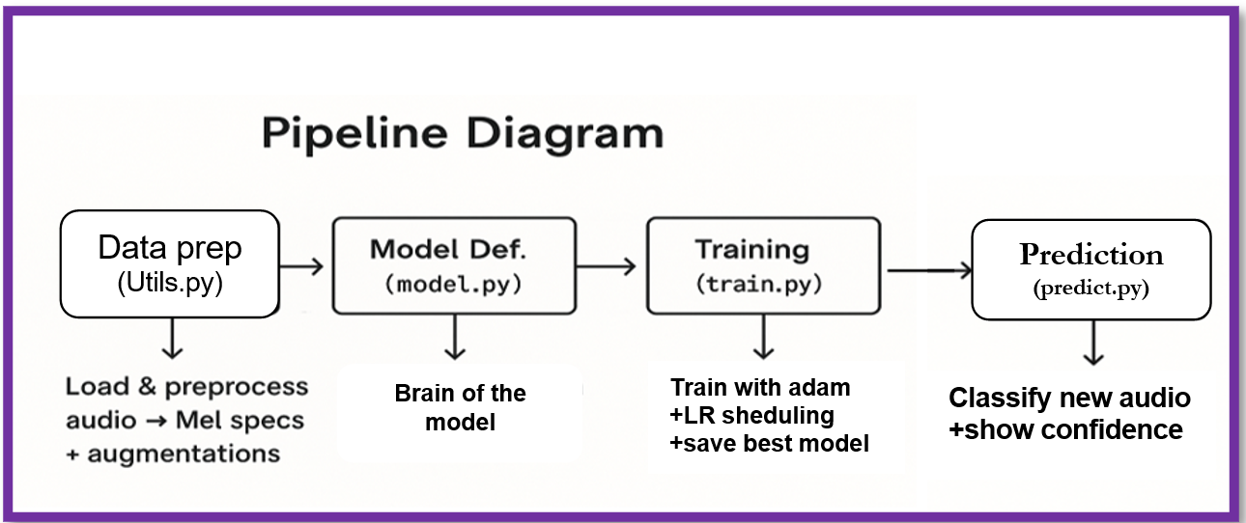
AI Voice Detection – System Pipeline

Slide 57
AI Voice Detection
This system detects whether a voice is human or AI-generated by applying a complete machine learning pipeline, from audio input to binary classification.
1. Data Preparation (utils.py)
Already explained earlier.
2. Model Architecture (model.py)
A 3-layer Convolutional Neural Network (CNN) processes the spectrograms.
Includes Batch Normalization and Dropout layers for improved stability and reduced overfitting.
Uses adaptive pooling to support variable-length inputs.

Slide 58
AI Voice Detection
Key Takeaways
End-to-End Flow: Raw audio → spectrograms → CNN → prediction.
Consistency: Identical preprocessing ensures reliable performance.
Adaptability: Supports variable input lengths using adaptive pooling.
Robustness: Data augmentation and dropout enhance generalization and pitch shifting.
3. Training Process (train.py)
where we teach our AI to distinguish real human voices from AI-generated ones.
4. Inference (predict.py)
Predict new samples of voices

Slide 59
CNN Model for Voice Detection
What It Does
This model analyzes audio spectrograms and classifies whether the voice is real (human) or fake (AI-generated) using a Convolutional Neural Network (CNN).
Model Architecture
Input: A visual representation of the audio called a Mel spectrogram
3 Convolutional Layers:
1st layer: Detects simple features (like edges in sound).
2nd layer: Combines them into textures (like voice modulations).
3rd layer: Recognizes full speech patterns
Adaptive Pooling:
Automatically adjusts to different audio lengths
Fully Connected Layers:
Final decision-making layers that classify the voice as Real or Fake

Slide 60
CNN Model for Voice Detection
Spectrograms contain rich voice information (pitch, timbre, frequency)
CNNs are well-suited for recognizing patterns in 2D inputs like spectrograms
The model is trained to focus on subtle differences between human and AI-generated speech
Key Features
Dropout (50%): Helps prevent the model from memorizing the training data
Flexible Input: Works with audio of different durations
Lightweight Design: Fast and efficient for real-time applications

Slide 61
Training the Voice Detection Model
Purpose
This script trains the voice detection model using labeled audio spectrograms and saves the best-performing version for future use.
1. Training Setup
Input: Preprocessed Mel spectrograms (Real vs. Fake voices)
Data Split:
80% for training
20% for validation
Batching: Audio data is grouped for efficient learning, with random shuffling to improve generalization
Augmentation: (pitch/noise changes) makes the model robust to real-world variations
Gpu usage: speeds up training 10-100x vs CPU

Slide 62
Training the Voice Detection Model
2. Training Configuration
Loss Function: Cross-entropy (measures prediction accuracy)
Optimizer: Adam (used for fast and stable convergence)
Learning Rate Scheduler: Automatically lowers the learning rate if validation performance stops improving
Dropout (50%): Helps prevent the model from memorizing the training data
Normalizes input in range: (−1,1)
3. Training Loop Summary
Forward Pass: Model makes predictions
Backward Pass: Updates model weights using errors
Validation Check: Evaluates performance on unseen data
Model Saving: Only the best-performing model is saved (best_voice_detector_model.pth)

Slide 63
Training the Voice Detection Model
Why This Matters ?
4. Performance Tracking
During each training cycle (epoch), the system tracks:
Training and Validation Loss
And Accuracy
F1 Score (balances precision and recall, useful for class imbalance)
Consistency: Consistent training and
evaluation setup
Efficiency: Adaptive learning rate speeds up training
Reliability: Model is only saved when performance improves on unseen data

Slide 64
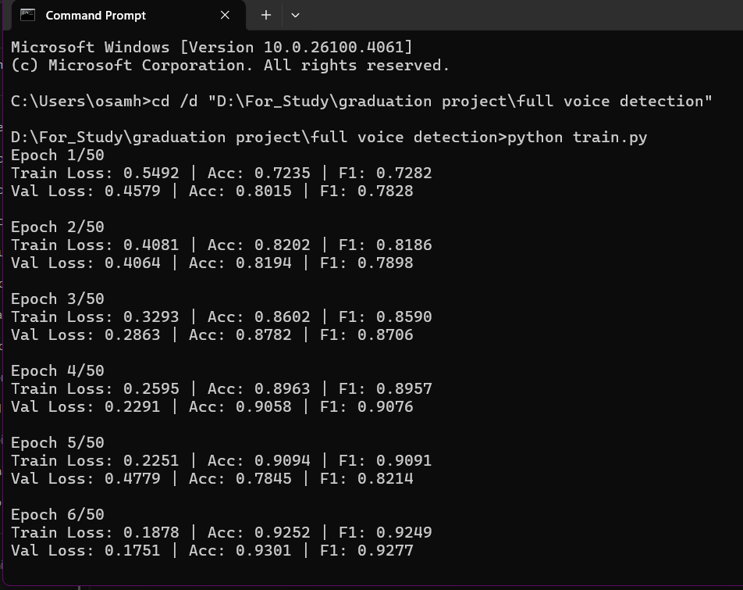
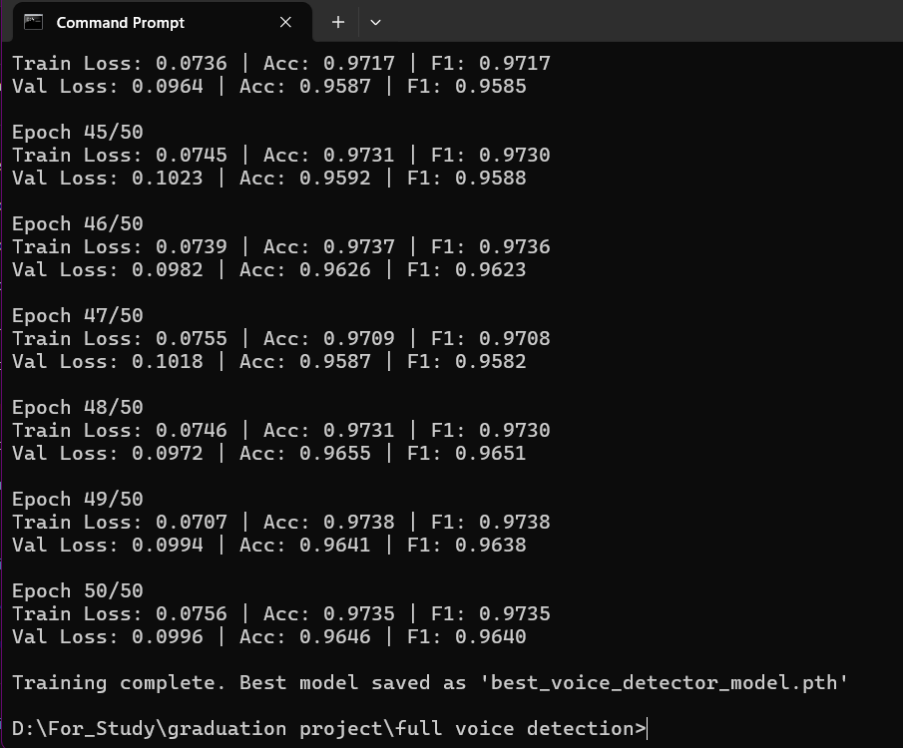
Model Training Performance

Slide 65
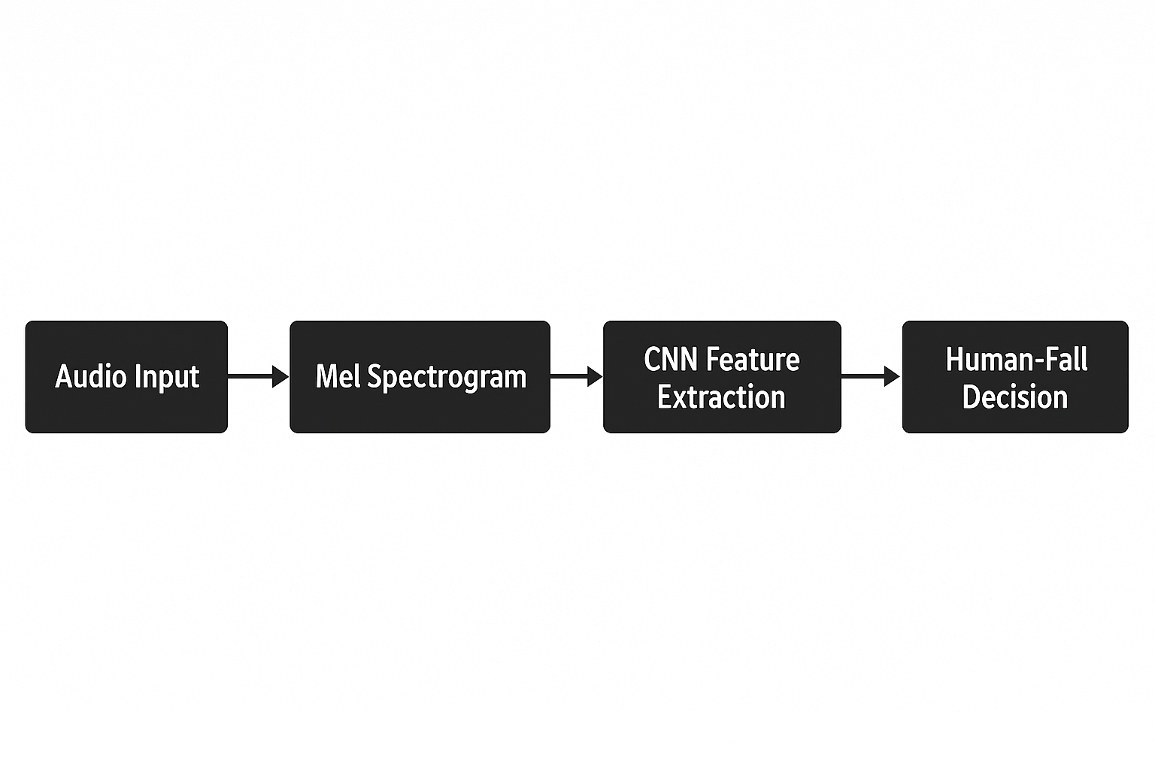
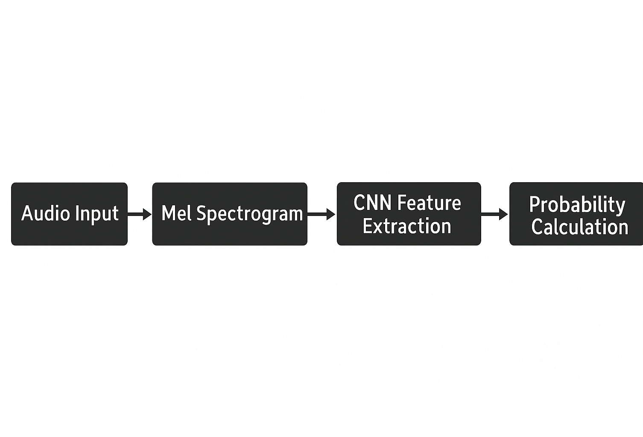
Prediction New Voices

Slide 66
Prediction New Voices
Purpose
Uses the trained model to classify new voice samples as either Real Human Voice or Fake AI Voice, with confidence scores.
Prediction Workflow
Input: User provides a .wav file
Preprocessing:
Converts audio to a Mel spectrogram
Normalizes input just like in training range: (−1,1)
Model Inference:
Loads the trained model (best_voice_detector_model.pth)
Runs prediction without computing gradients (for speed)
Output:
Predicted label: Real or Fake
Confidence scores for both classes (via softmax)
Key Features
User-Friendly: Simple terminal prompt for file input
Clear Results: Displays both prediction and confidence levels

Slide 67
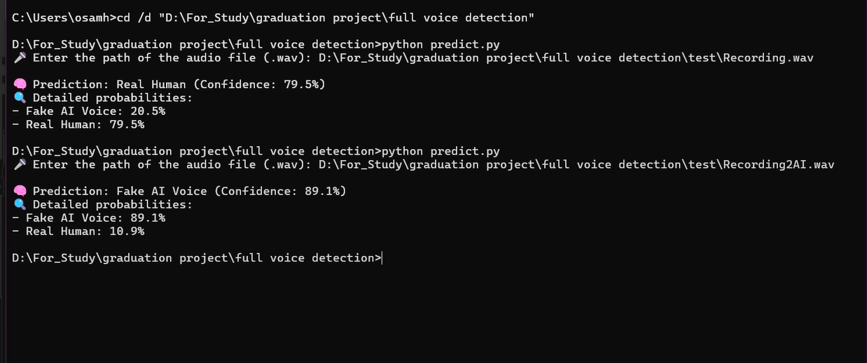
Example Output (CLI Display)
The prediction of two voice clips the first one is real human and the second is AI generated

Slide 68
06
Problems We counter

Slide 69
Challenges Faced During Development
1. Limited Computational Resources
Training deep learning models, especially for voice conversion and detection, requires high-performance GPUs and large memory, which were not available to us locally.
We had to rely on the free tier of Google Colab, which imposes time and hardware limitations.
2. Python Version Compatibility in Google Colab
The noise cancellation module required a newer version of Python (3.10), which is not natively supported in Google Colab.
Manual setup was needed to install and configure the correct environment, which added complexity to the development process.

Slide 70
3. Dependency on Google Colab Sessions
Due to runtime restrictions, we had to work in short session windows and often lost progress.
In some cases, we needed to use multiple Colab accounts just to resume model training or testing after session limits were reached.
4. Impact on Real-Time Performance Goals
Because of these limitations, we could not implement or demonstrate a fully real-time voice conversion system.
With stronger resources (e.g., dedicated GPUs or cloud credits), our modules could have achieved better efficiency, speed, and scalability.
Summary
These challenges affected our workflow but also taught us how to adapt, optimize code for limited environments, and think creatively under constraints.

Slide 71


CONCLUSION

Slide 72
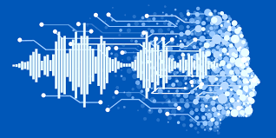
Conclusion
Throughout this project, we successfully designed and implemented a set of intelligent audio tools that address some of the most pressing challenges in modern voice communication and audio processing.
Key Achievements
Developed a Noise Cancellation System that enhances voice clarity by removing background interference using AI-powered signal separation.
Built a Voice Changing System capable of transforming a speaker’s voice into another, leveraging deep feature extraction and high-fidelity audio synthesis.
Created an AI Voice Detection Tool to distinguish between real human speech and AI-generated voices with high accuracy and transparency.

Slide 73
Looking Ahead
With access to better computational resources, our goal is to enhance these systems to operate in real-time and support larger, more complex datasets.
We aim to evolve the Noise Cancellation and Voice Changing modules into virtual microphone tools that can run live during calls, recordings, or streaming.
For the AI Voice Detection tool, we envision building a lightweight, accessible application that can detect synthetic audio on the fly—useful for journalists, educators, and security analysts.
These future developments will help bring our technologies closer to practical deployment in everyday communication platforms and professional environments.

Slide 74
TESTING

Slide 75
THANKS!
DO YOU HAVE ANY QUESTIONS?

